Slide 1
DSC 630 Milestone 4
Holly Erickson

Slide 2

Project Overview
Part One:
Using MLB data, use Kmeans to create pitch clusters. Find commonalities in the performance of the pitches in each cluster to offer insights to players so that they might improve their performance.
Part Two:
Predict the exit speed of a ball coming off of a bat using a random forest regressor.

Slide 3
Part One - Model Selection
Use KMeans algorithm to divide pitches into clusters
Minimizes the sum of the squared euclidean distance between the data points and the cluster’s centroid (arithmetic mean of all the data points that belong to that cluster).

Slide 4
Part One - Preprocessing
Split pitch data into pitcher handedness (right or left)
The release point is different for these pitches, so even if the speed and breaks are similar, the pitch will be very different from the batter’s perspective.
Do not split pitch data by pitch type (fastball, slider, etc.)
Standardize data - release speed, pfxx, pfxz

Slide 5
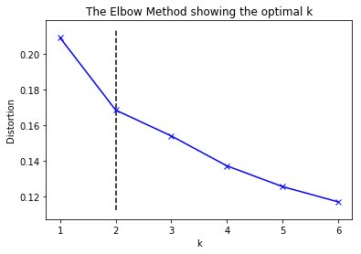
Part One - Model Tuning
Determine optimal number for K (I choose 30)

Slide 6
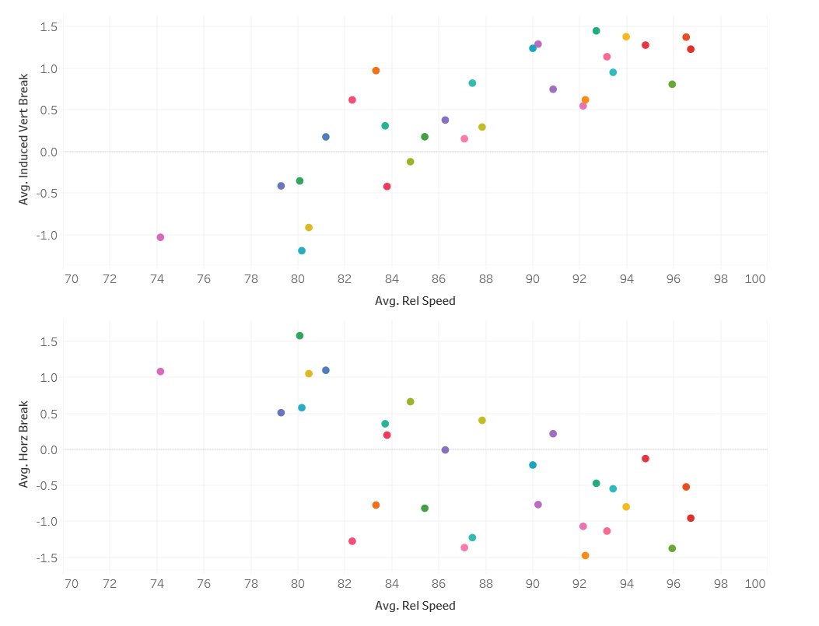
Right Pitchers Cluster Centers:
Induced Vertical Break
& Release Speed
Horizontal Break
& Release Speed
Notice the difference in horizontal
break between right and left
pitchers.

Slide 7
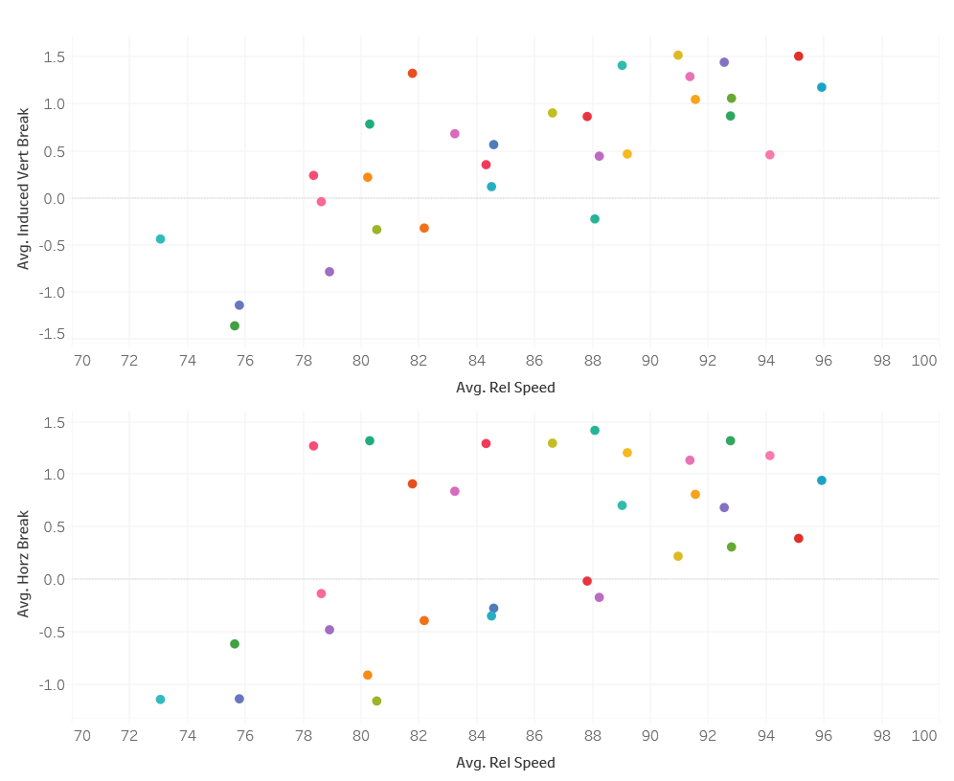
Left Pitchers Cluster Centers:
Induced Vertical Break
& Release Speed
Horizontal Break
& Release Speed

Slide 8
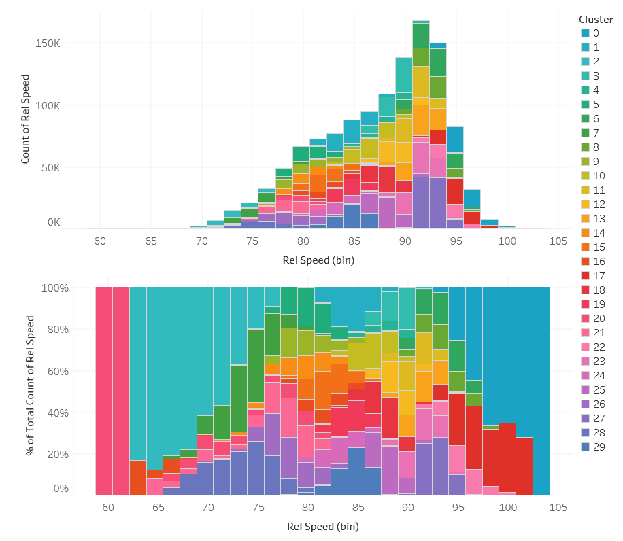
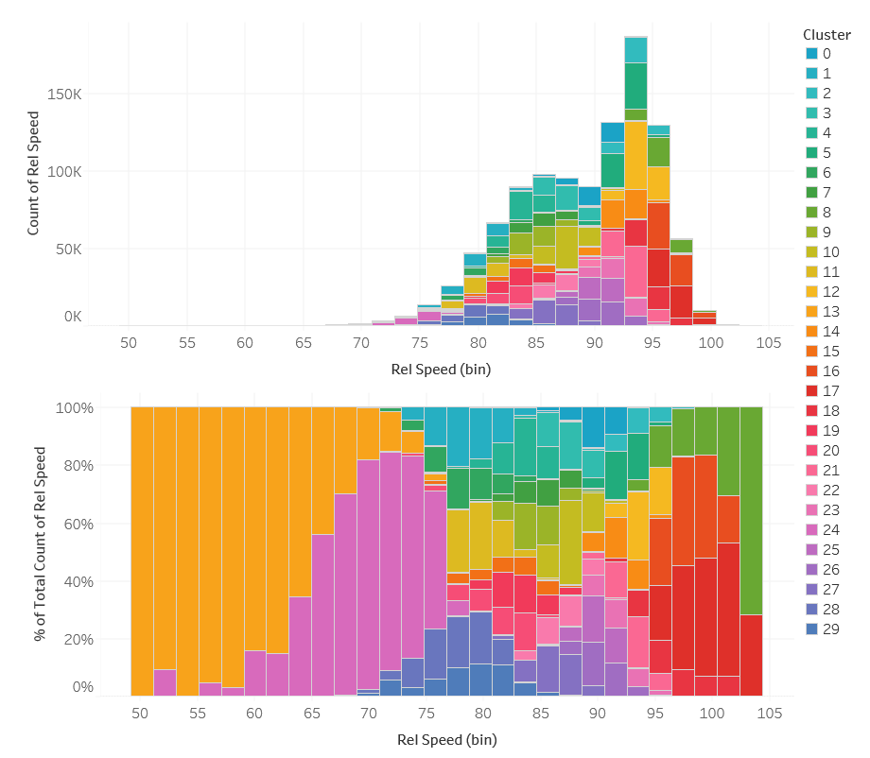
Left Pitchers Cluster Distribution
Right Pitchers Cluster Distribution

Slide 9
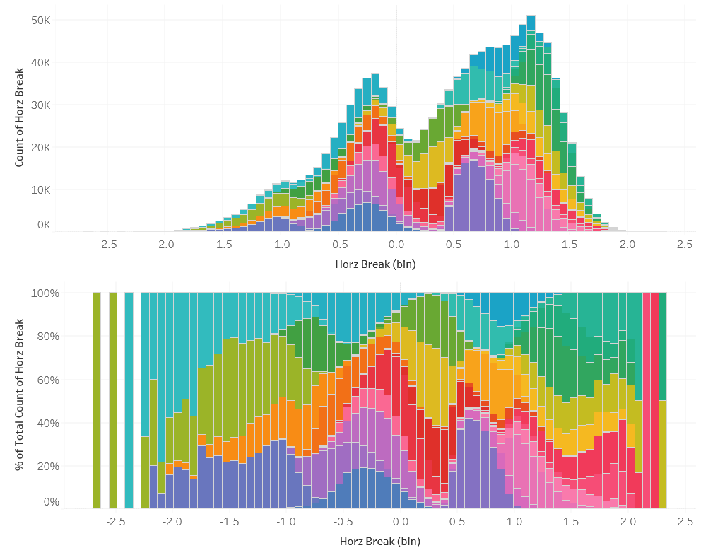
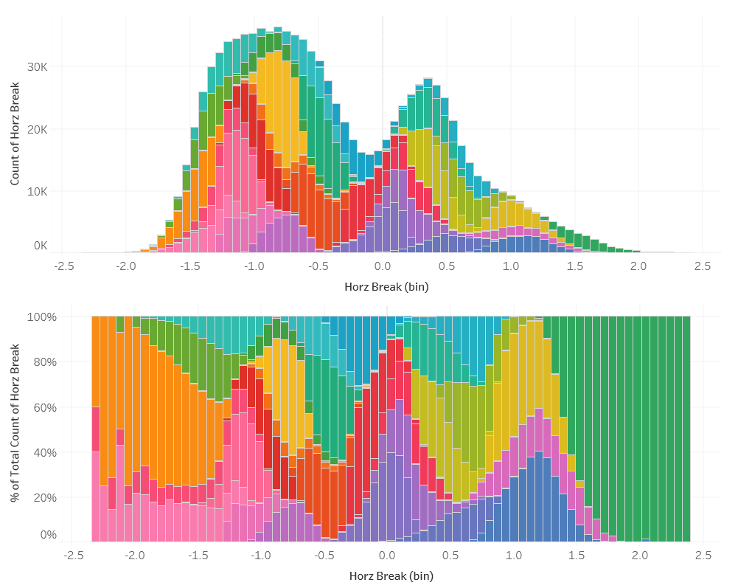
Left Pitchers Cluster Distribution
Right Pitchers Cluster Distribution

Slide 10
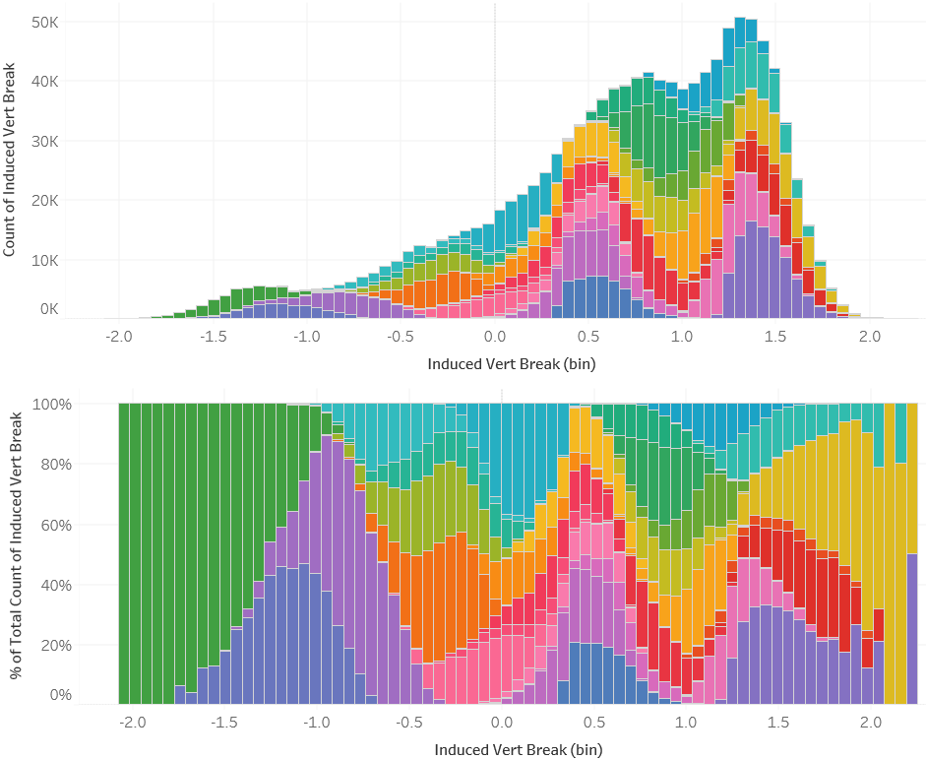
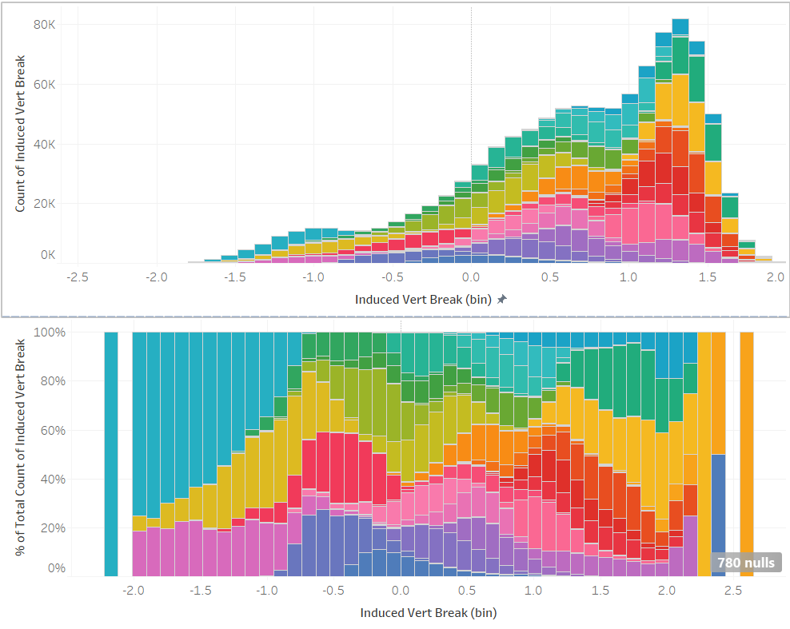
Left Pitchers Cluster Distribution
Right Pitchers Cluster Distribution

Slide 11
Part One - Creating Insights
Top or bottom of the zone and inside or outside side of the zone
Top or bottom of the zone and inside or outside side of the zone for left-handed and for right-handed batters
Zone (1 - 13)
Zone (1 - 13) for left-handed and for right-handed batters

Slide 12
Part Two - Feature engineering to predict exit speed
Find each stadium latitude, longitude
Use API to get elevation for each stadium
Use API to get historic weather for each pitch (temp, barometric pressure)
Use parts a - c plus 9 features from original dataset to calculate the True Spin

Slide 13
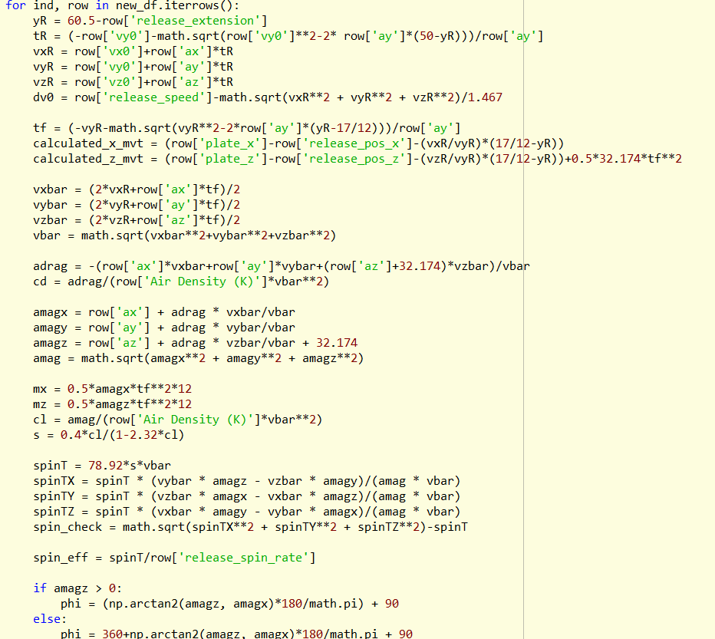

Slide 14
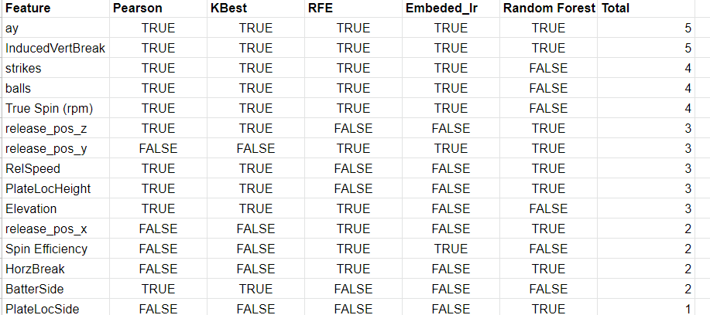
Part Two - Feature Selection

Slide 15
Part Two - Cross Validation
Hyperparameter tuning on cross validation set
For each potential model, used GridSearch CV
Winning Model:
RandomForestRegressor: max-depth of 10, with n_estimators set to 500

Slide 16
Part Two - Evaluate Model
R^2 of .28
What does this mean?
28% of the variance of Exit Speed can be explained by the independent variables in the model.

